Slide 1
Logistic Regression & Survival Analysis
Analysis of binary outcome & time to event data
Larry Holmes, Jr
Joabyer Hossain
Stats Research, Lecture 7
November 13, 2008

Slide 2
Presentation Objectives
At the end of this presentation, participants should be able to :
Rationale for logistic regression, conduct and interpretation of result
Survival analysis
  Measure Time and Events
  Understand Truncation and Censoring
  Understand Survival and Hazard Functions
  Define Competing Risks
  Understand Models and Hypothesis Testing
    Log rank
    Kaplan- Meier survival curve & estimates
    Cox Proportional Hazards Model (semi-parametric model)

Slide 3
What is Logistic Regression?
  Logistic regression is often used because the relationship between the DV (a discrete variable) and a predictor is non-linear
    Blood glucose level and diabetes mellitus
    Hypertension and LDL level

Slide 4
Logistic Regression
In logistic regression:
Outcome variable is binary
Purpose of the analysis is to assess the effects of multiple explanatory variables, which can be numeric and/or categorical, on the outcome variable.

Slide 5
Requirements for Logistic Regression
The Following need to be specified:
An outcome variable with two possible categorical outcomes (1=success; 0=failure).
Estimating the probability P of the outcome variable.
Linking the outcome variable to the explanatory variables.
Estimating the coefficients of the regression equation, as well as their confidence intervals.
Testing the goodness of fit of the regression model.

Slide 6
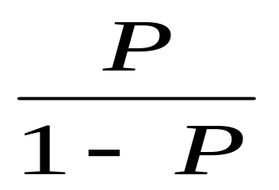
Measuring the Probability of Outcome
The probability of the outcome is measured by the odds of occurrence of an event.
If P is the probability of an event, then (1-P) is the probability of it not occurring.
Odds of success = P / 1-P

Slide 7
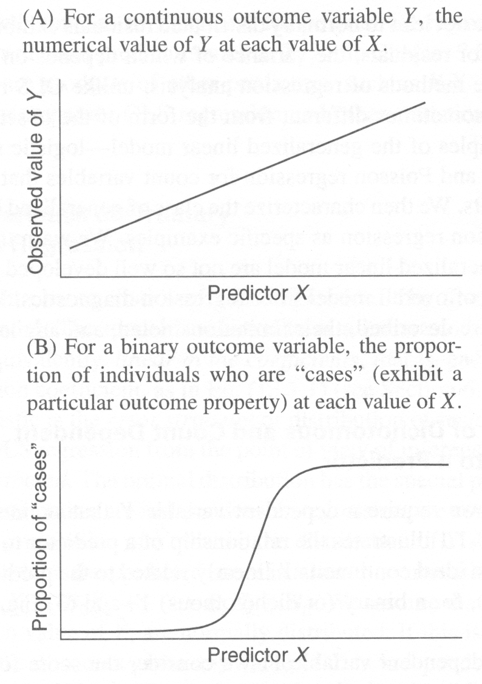
The logistic function

Slide 8
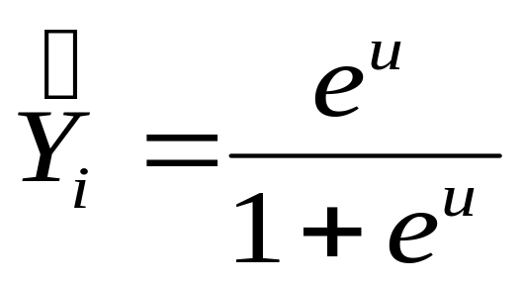
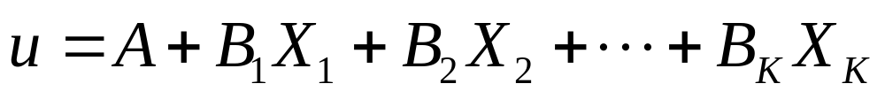
The logistic function
Where Y-hat is the estimated probability that the ith case is in a category and u is the regular linear regression equation:

Slide 9
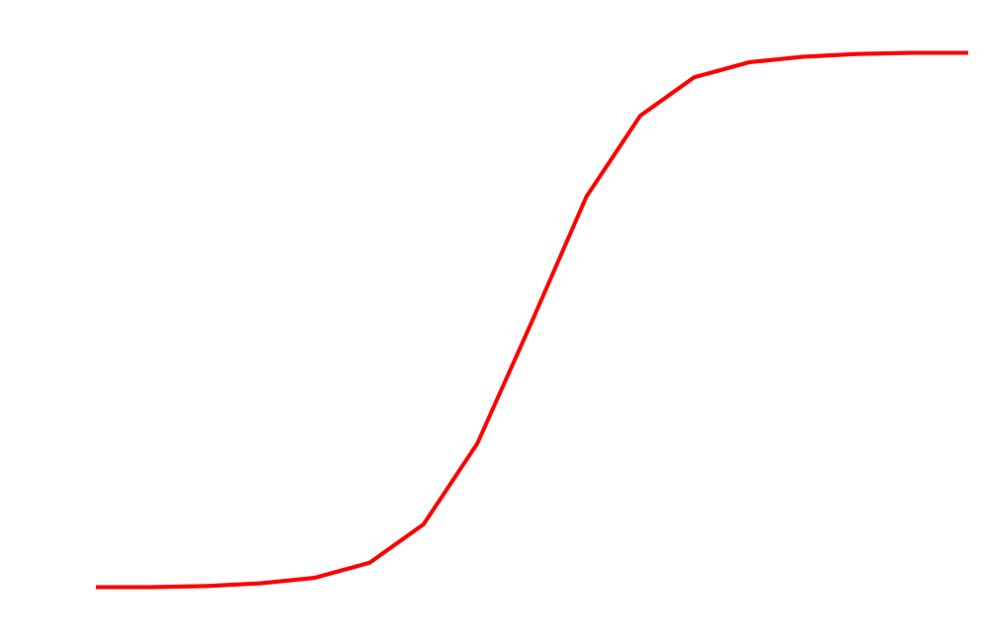

Logistic function
For a response variable y with p(y=1)= P and p(y=0) = 1- P
Logistic regression will allow for the estimation of an equation that fits a curve the age/probability of CHD relationship
Probability of disease
A regression method to deal with the case when the dependent variable y is binary (dichotomous)
x

Slide 10
The logistic function
Change in probability is not constant (linear) with constant changes in X
This means that the probability of a success (Y = 1) given the predictor variable (X) is a non-linear function, specifically a logistic function

Slide 11
The logistic function
It is not obvious how the regression coefficients for X are related to changes in the dependent variable (Y) when the model is written this way
Change in Y(in probability units)|X depends on value of X. Look at S-shaped function

Slide 12
The Logistic Regression
The joint effects of all explanatory variables put together on the odds is
Odds = P/1-P = e ^{α + β1X1 + β2X2 + …+βpXp}
Taking the logarithms of both sides
Log{P/1-P} = log ^{α+β1X1+β2X2+…+βpXp}
Logit P = α+β1X1+β2X2+..+βpXp
The coefficients β1, β2, βp are such that the sums of the squared distance between the observed and predicted values (i.e. regression line) are smallest.

Slide 13
The Logistic Regression
Logit p = α + β1X1 +β2X2 + .. + βpXp
α represents the overall disease risk
β1 represents the fraction by which the disease risk is altered by a unit change in X1
β2 is the fraction by which the disease risk is altered by a unit change in X2
……. and so on.
What changes is the log odds. The odds themselves are changed by e^{β}
If β = 1.6 the odds are e^{1.6} = 4.95

Slide 14
Logistic Regression-Demo
MS-Excel: No default functions
SPSS: Analyze > Regression > Binary Logistic > Select Dependent variable: > Select independent variable (covariate)

Slide 15
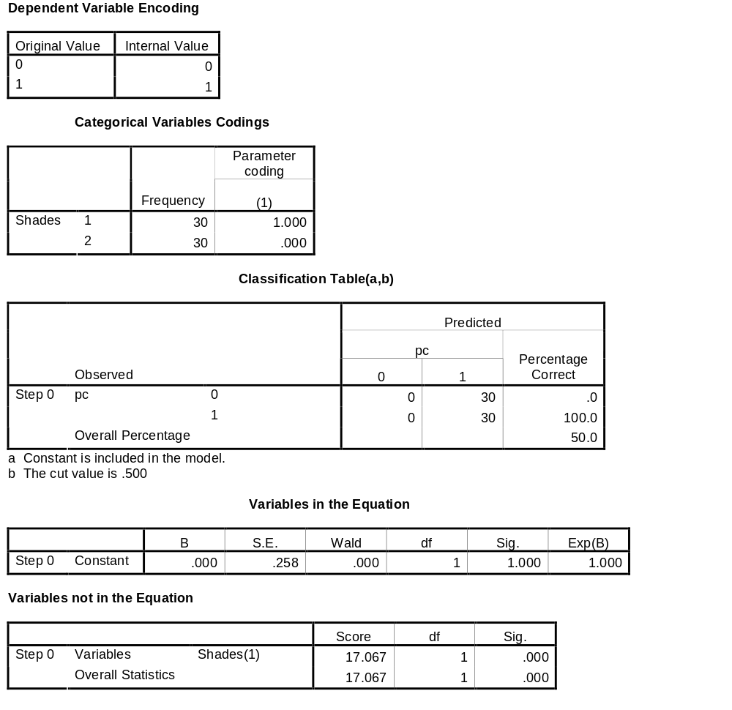
Logistic Regression SPSS output

Slide 16
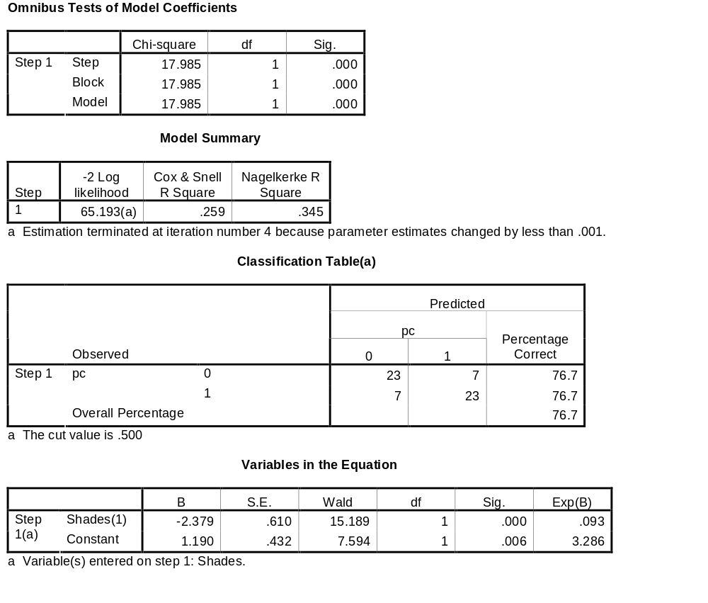
Logistic Regression SPSS output

Slide 17

Regression vs. Survival Analysis

Slide 18
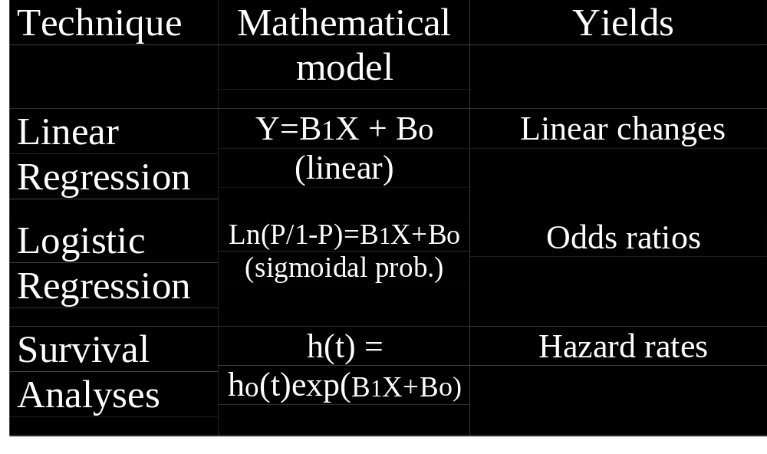
Regression vs. Survival Analysis

Slide 19
What is survival analysis?
Model time to failure or time to event
  Unlike linear regression, survival analysis has a dichotomous (binary) outcome
  Unlike logistic regression, survival analysis analyzes the time to an event
    Why is that important?
Able to account for censoring
Can compare survival between 2+ groups
Assess relationship between covariates and survival time
Notes:
Draw schematic of temporality.

Slide 20
Survival Analysis
Survival analysis deals with making inference about EVENT RATES
Rate at t = Rate among those at risk at t
Deals with Median survival (50%) .
Not Mean survival (need everyone to have an event) …..Why?
Survival vs. time-to-event
Outcome variable = event time
Examples of events:
  Death, infection, MI,prostate cancer death, hospitalization
  Recurrence of cancer after treatment

Slide 21
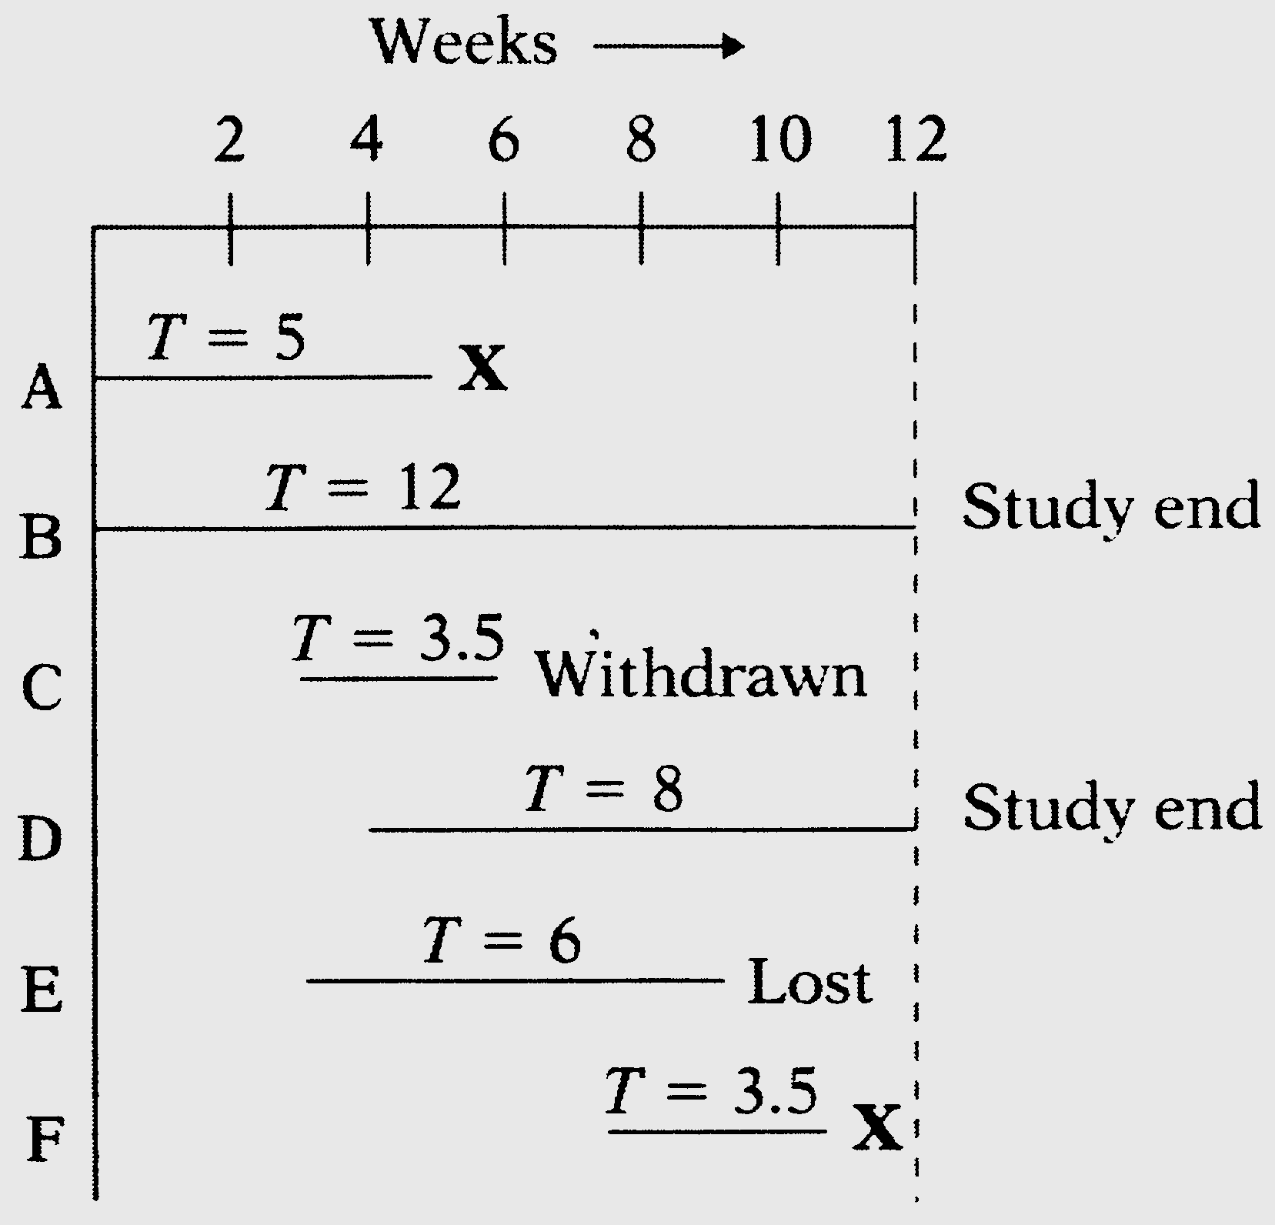
Types of censoring
Subject does not experience event of interest
Incomplete follow-up
  Lost to follow-up
  Withdraws from study
  Dies (if not being studied)
Left or right censored
Notes:
X = dies

Slide 22
Survival Function
S(t) = P[ T ≥ t ] = 1 – P[ T < t ]
Plot: Y axis = % alive, X axis = time
Proportion of population still without the event by time t

Slide 23
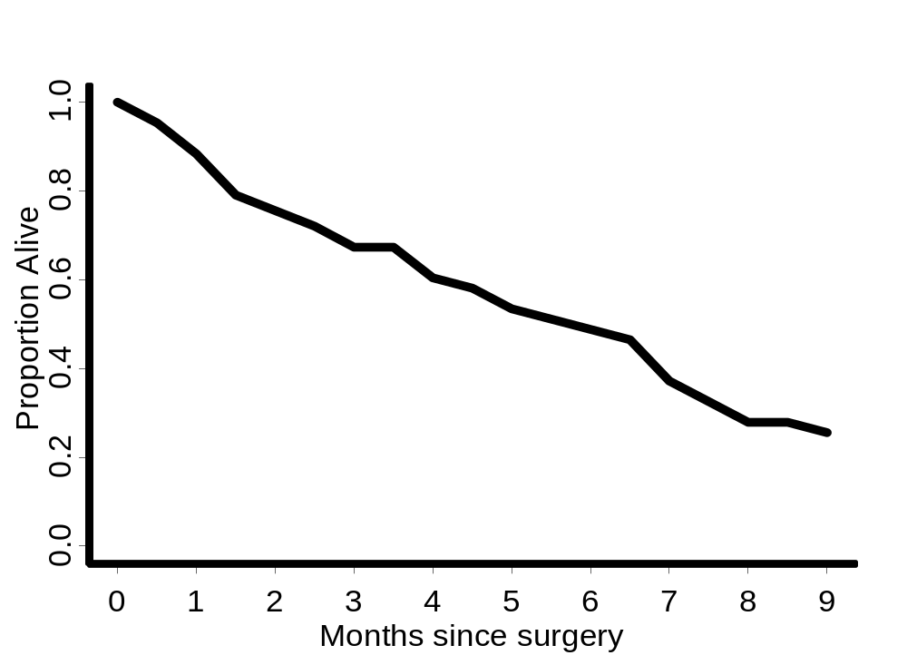
Survival Curve
Survival Curve

Slide 24
Hazard Function
Also termed incidence rate, instantaneous risk, force of mortality
λ(t)
Event rate at t among those at risk for an event
Key function
Estimated in a straightforward way
  Censored
  Truncated

Slide 25
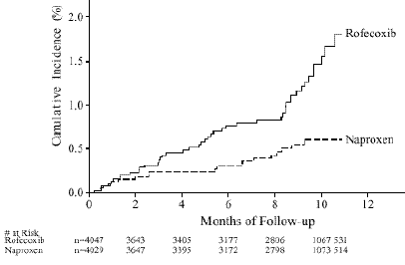
Time to Cardiovascular Adverse Event in VIGOR Trial
Notes:
Y-axis is 1-S(t); rofecoxib = Vioxx

Slide 26
Hazard Function
Event = death, scale = months since Tx
“λ(t) = 1% at t = 12 months”
“At 1 year, patients are dying at a rate of 1% per month”
“At 1 year the chance of dying in the following month is 1%”

Slide 27
Relationship between survivor function and hazard function
Survivor function, S(t) defines the probability of surviving longer than time t
  this is what the Kaplan-Meier curves show.
  Hazard function is the derivative of the survivor function over time h(t)=dS(t)/dt
    instantaneous risk of event at time t (conditional failure rate)
Survivor and hazard functions can be converted into each other

Slide 28
Use of survival analysis: clinical trial
Accrual into the study over 2 years
Data analysis at year 3
Reasons for exiting a study
  Died
  Alive at study end
  Withdrawal for non-study related reasons (LTFU)
  Died from other causes

Slide 29
Kaplan-Meier
One way to estimate survival
Nice, simple, can compute by hand
Can add stratification factors
Cannot evaluate covariates like Cox model
No sensible interpretation for competing risks

Slide 30

Kaplan-Meier estimate
Multiply together a series of conditional probabilities
Time t_{i} | # at risk | # events
0 | 20 | 0 | 1.00
5 | 20 | 2 | [1-(2/20)]*1.00=0.90
6 | 18 | 0 | [1-(0/18)]*0.90=0.90
10 | 15 | 1 | [1-(1/15)]*0.90=0.84
13 | 14 | 2 | (1-(2/14)]*0.84=0.72

Slide 31
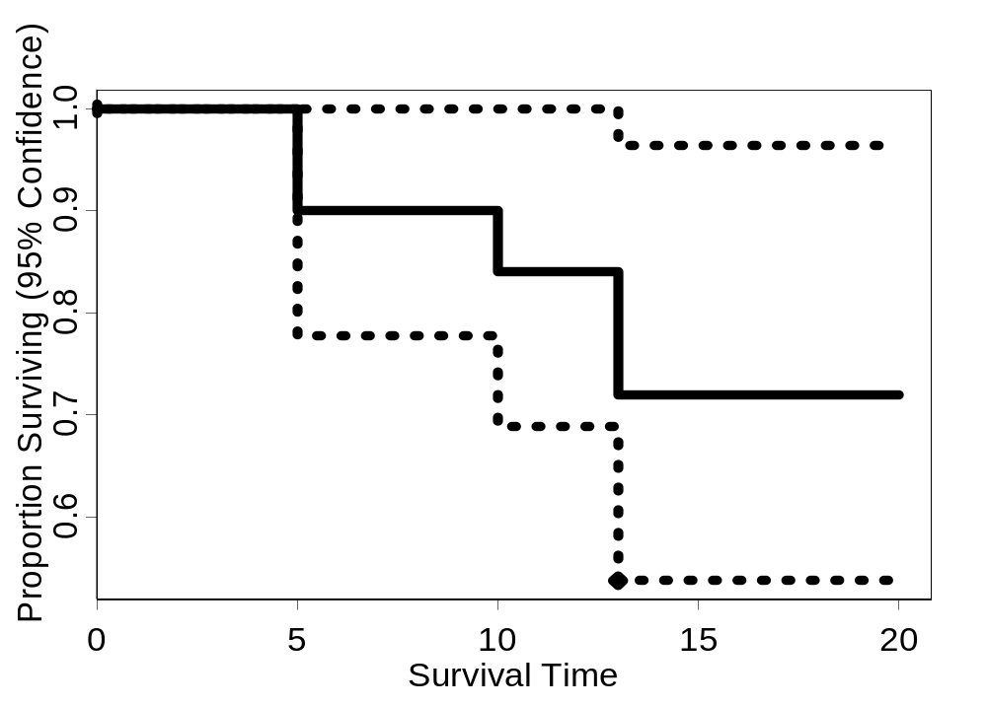
Kaplan-Meier Curve

Slide 32
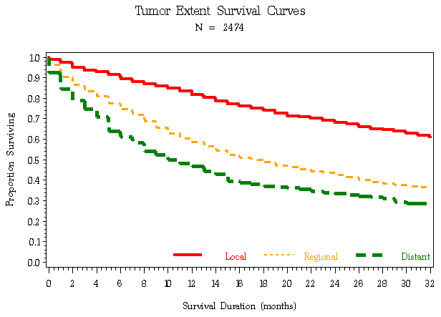
Kaplan Meier Curve

Slide 33
Limit of Kaplan-Meier curves
What happens when you have several covariates that you believe contribute to survival?
Example
  Smoking, hyperlipidemia, diabetes, hypertension, contribute to time to myocardial infarct
Can use stratified K-M curves – for 2 or maybe 3 covariates
Need another approach – multivariate Cox proportional hazards model is most common -- for many covariates
  (think multivariate regression or logistic regression rather than a Student’s t-test or the odds ratio from a 2 x 2 table)

Slide 34
Multivariable method: Cox proportional hazards
Needed to assess effect of multiple covariates on survival
Cox-proportional hazards is the most commonly used multivariable survival method

Slide 35
Cox proportional hazard model
Works with hazard model
Conveniently separates baseline hazard function from covariates
  Baseline hazard function over time
    h(t) = ho(t)exp(B1X+Bo)
  Covariates are time independent
  B1 is used to calculate the hazard ratio, which is similar to the relative risk
Semi-parametric

Slide 36
Cox Proportional Hazards Model
Add covariates to the model
Change in a prognostic factor → proportional change in the hazard (on the log scale)
Can test the effect of the prognostic factor as in linear regression - H₀: β=0

Slide 37
Limitations of Cox PH model
Does not accommodate variables that change over time
  Most variables (e.g. gender, ethnicity, or congenital condition) are constant
    If necessary, one can program time-dependent variables
    When might you want this?
Baseline hazard function, h_{o}(t), is never specified
  You can estimate h_{o}(t) accurately if you need to estimate S(t).
Notes:
Time-dependent variables: could be smoking, diet, or medications; effect of prior event on recurrence.

Slide 38
Summary
Survival analyses quantifies time to a single, dichotomous event
Handles censored data well
Survival and hazard can be mathematically converted to each other
Kaplan-Meier survival curves can be compared statistically and graphically
Cox proportional hazards models help distinguish individual contributions of covariates on survival, provided certain assumptions are met.

Slide 39
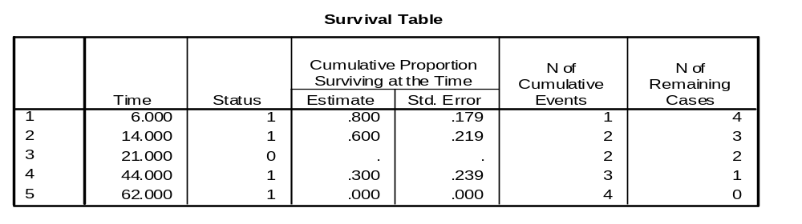
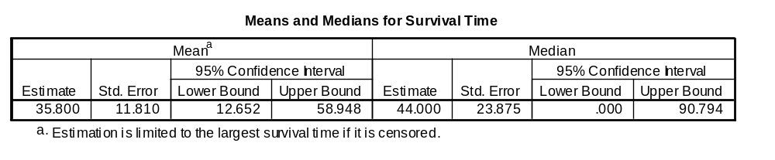
SPSS output of Survival functions

Slide 40
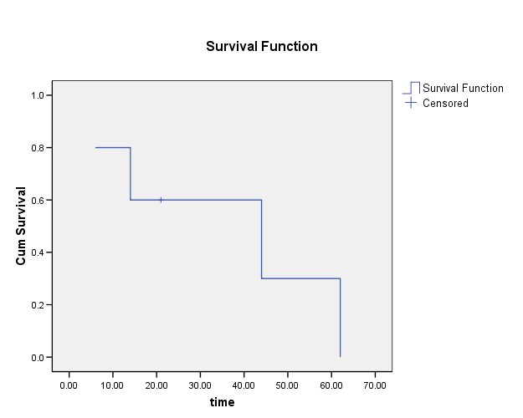
SPSS output of KM plot

Slide 41
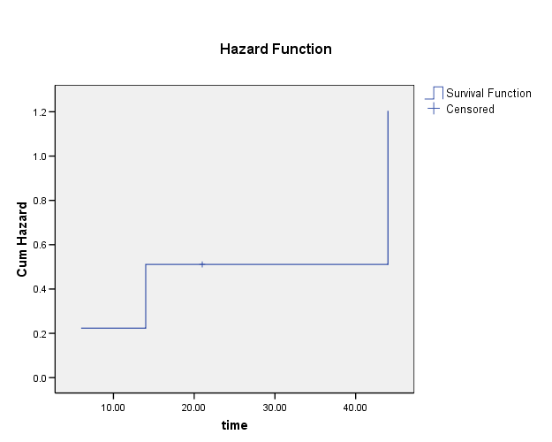
SPSS output of cumulative hazard

Slide 42
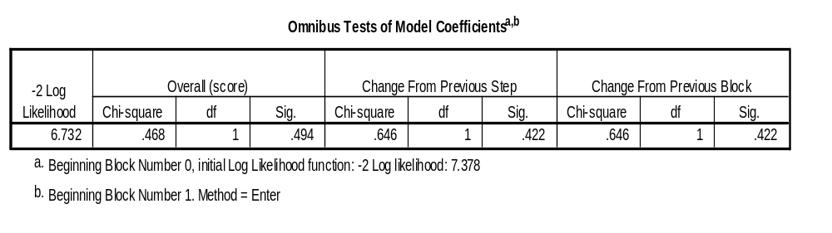
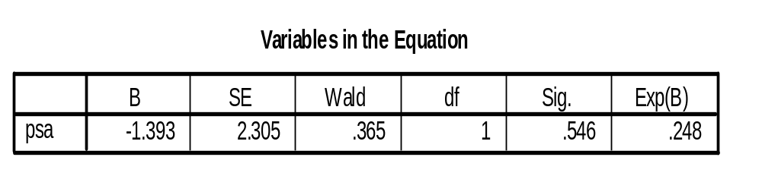
SPSS output of Cox Regression

